Slide 1

Spectrum Meet
Sprint 3

Slide 2
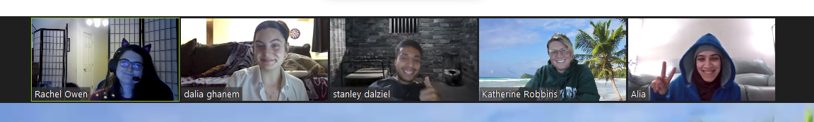
Team OOPsie!
Developers
Designers
Micro-Apps

Slide 3
Spectrum Meet
Spectrum Meet is a platform created to help families with neurodivergent children form and create friendships in a more understanding and supportive environment.

Slide 4
Designer Progress
Home & Learn More - Katherine Robbins
Meet the Team & Contact Us - Stanley Dalziel

Slide 5
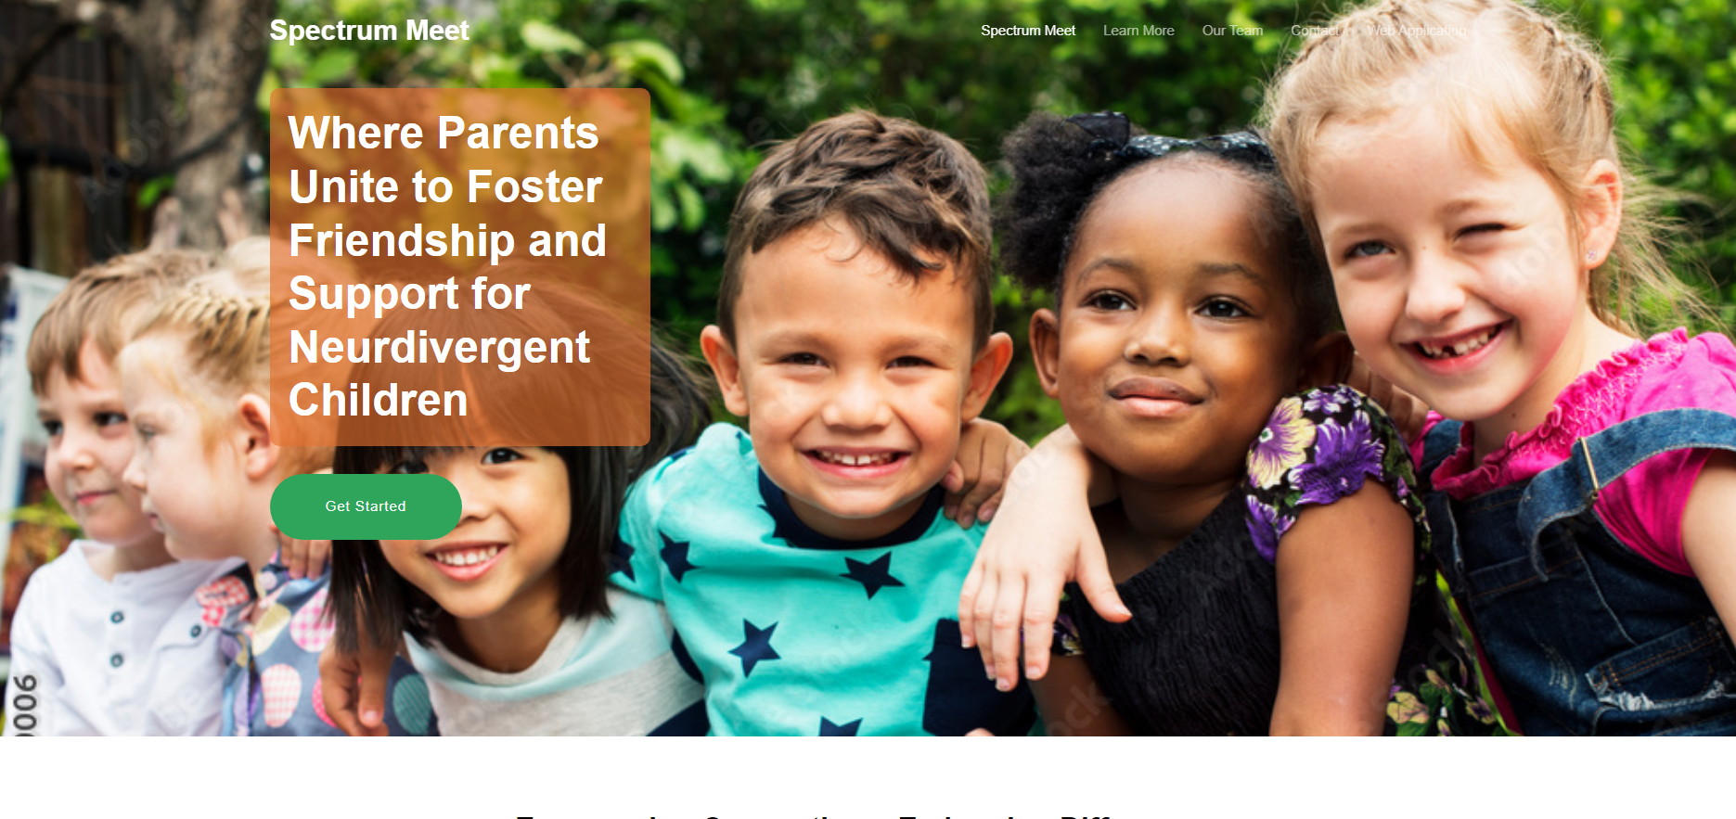
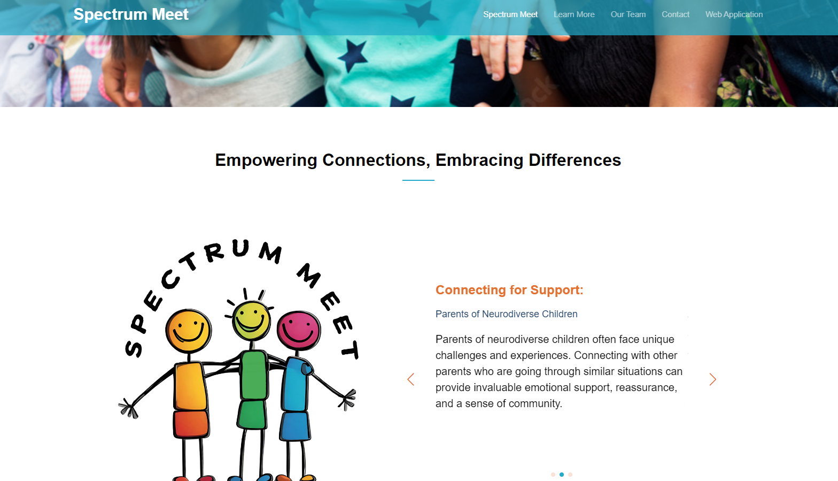
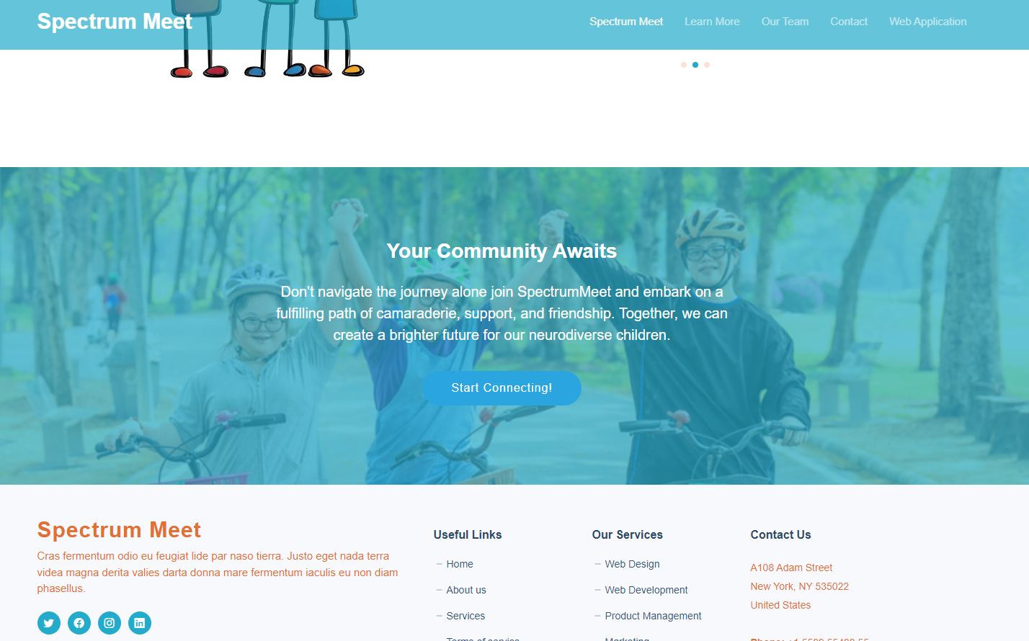
Home / Landing Page
Notes:
Working on enhancing the homepage to captivate users from their first visit, ensuring they grasp the core concept of Spectrum Meet immediately upon landing on the website.

Slide 6
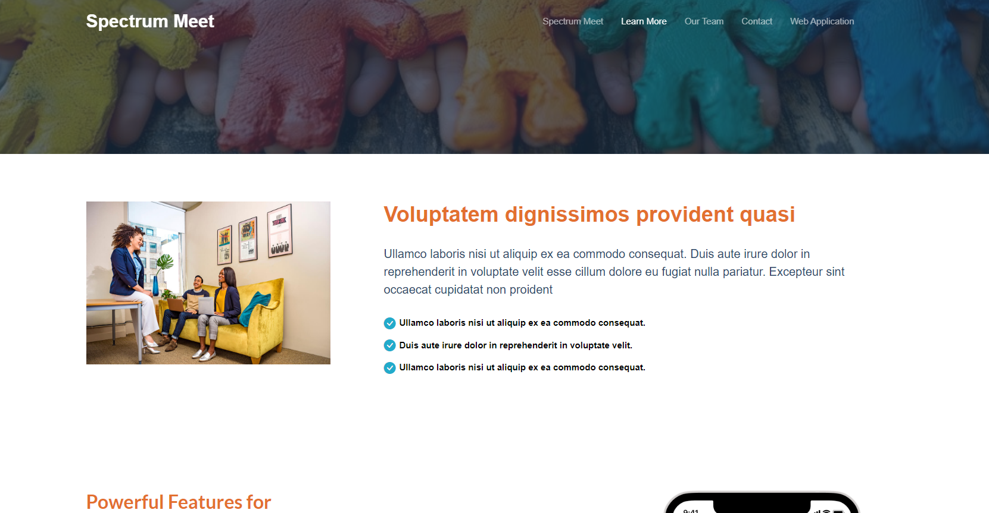
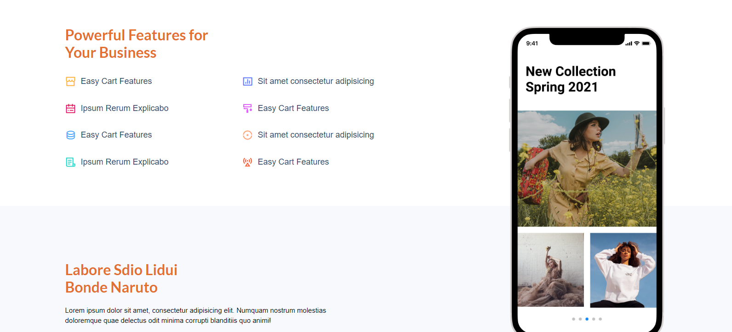
Learn More Page
Notes:
Page still mostly untouched

Slide 7
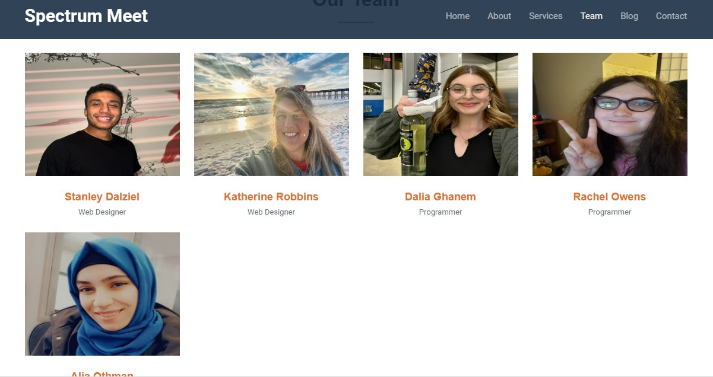
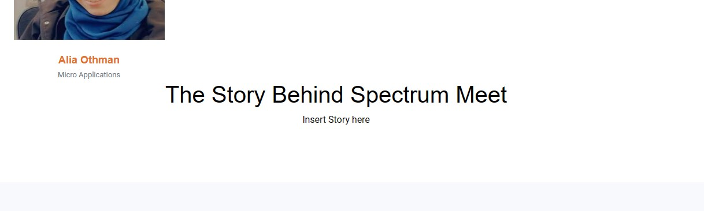
About The Team Page
Notes:
Style tweaking with the about the team page with an added section that is going to go In depth of the

Slide 8
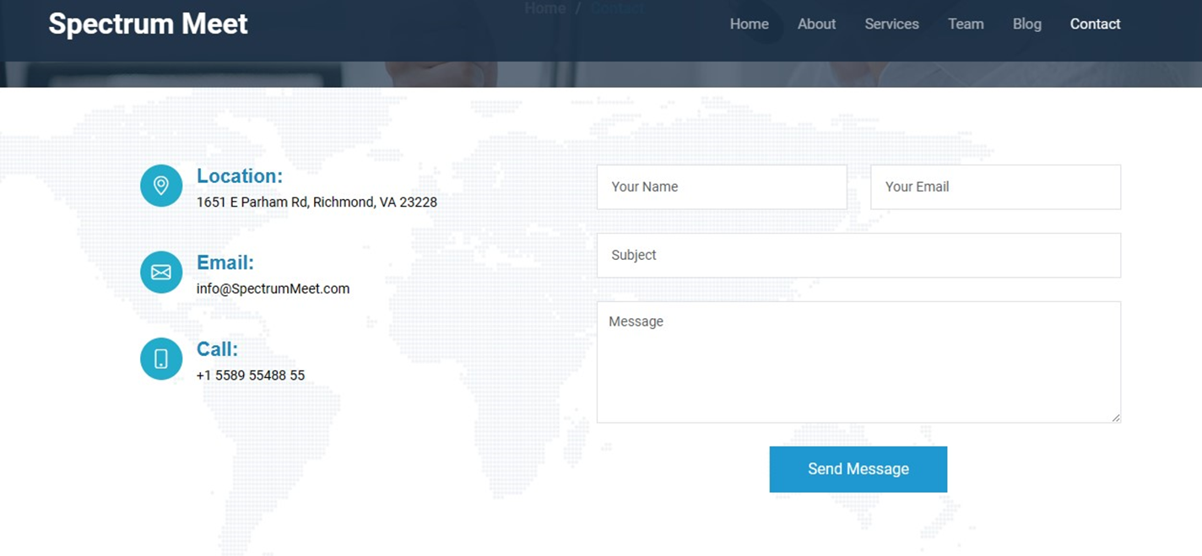
Contact Us Page
Notes:
Contact information page. The send message box is a feature that automatically relays to our emails any questions or comments

Slide 9
Development Progress
Dalia Ghanem & Rachel Owen

Slide 10
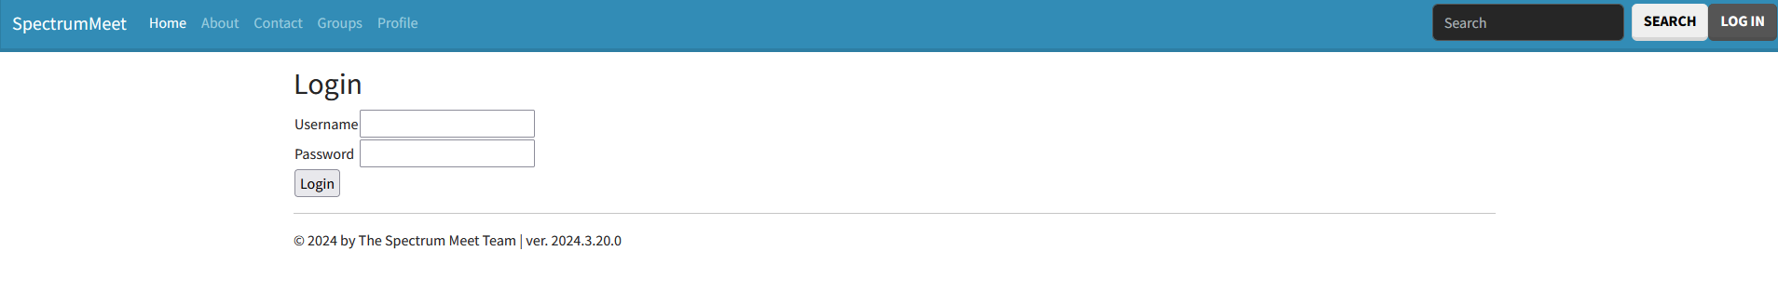
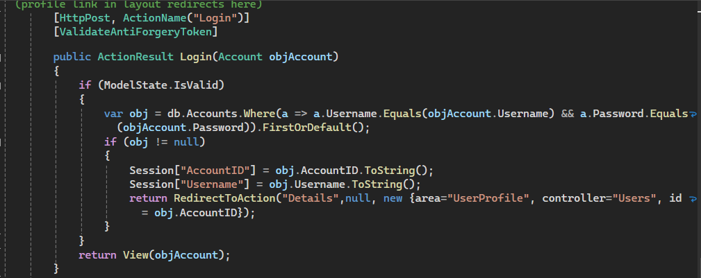
Login Page
Simple login page that verifies username and password. Profile link in navbar redirects to user’s profile page when logged in and the log-in page when not. Sign-ups and account creation pending

Slide 11
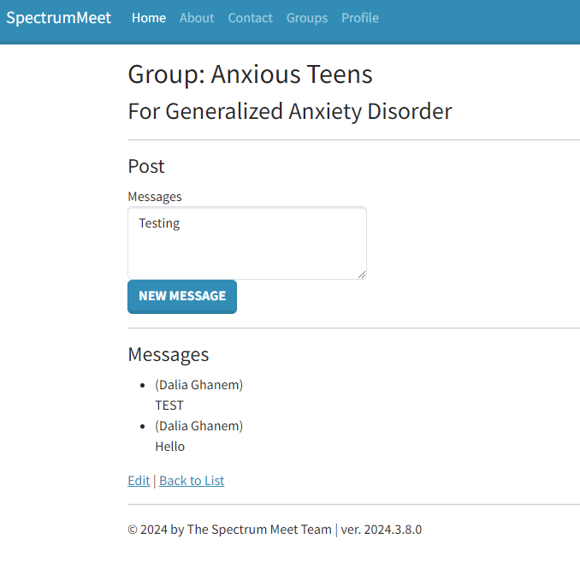
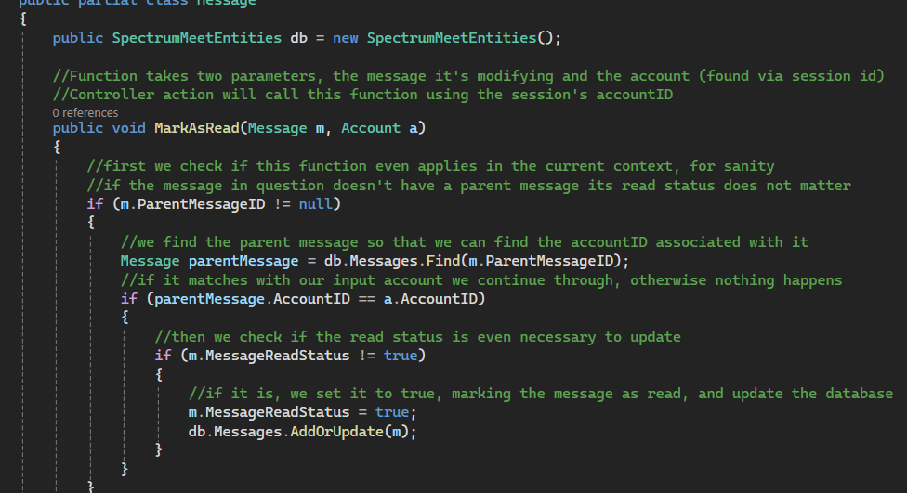
Messages
Working on messages within groups,
they currently render but new messages can’t be sent yet. Read/Unread functionality for replies is implemented.
Version number is wrong due to this being in IDE and not live at the time of this screenshot

Slide 12
What’s next:
Finishing up the Message system is priority 1, including
a user inbox and reply functions, afterwards
we plan to evaluate what is left to make the site functional.
Big priorities are Account Creation and getting Child Profiles
to function properly.
Notes:
The scaffolded areas we’ve created need to be properly configured and scripted to work with our design constraints.
Slightly lower priority is to edit our page to look more appealing and blend it with our web designers’ work on the promotional site’s visual design.

Slide 13
Micro - Apps Progress
Alia Othman

Slide 14
Micro- Apps
I created a team report using the data from capstone
I Create a marketing material for my team
I Create the Access Databases

Slide 15
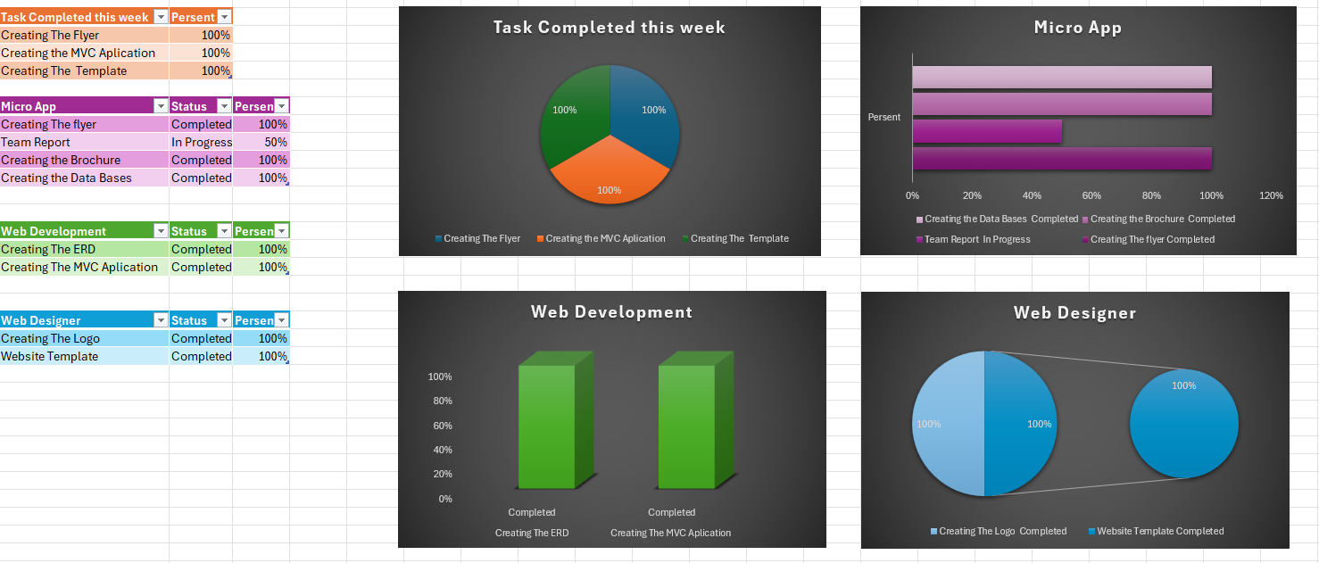
Team Report Chart Progress

Slide 16


Slide 17
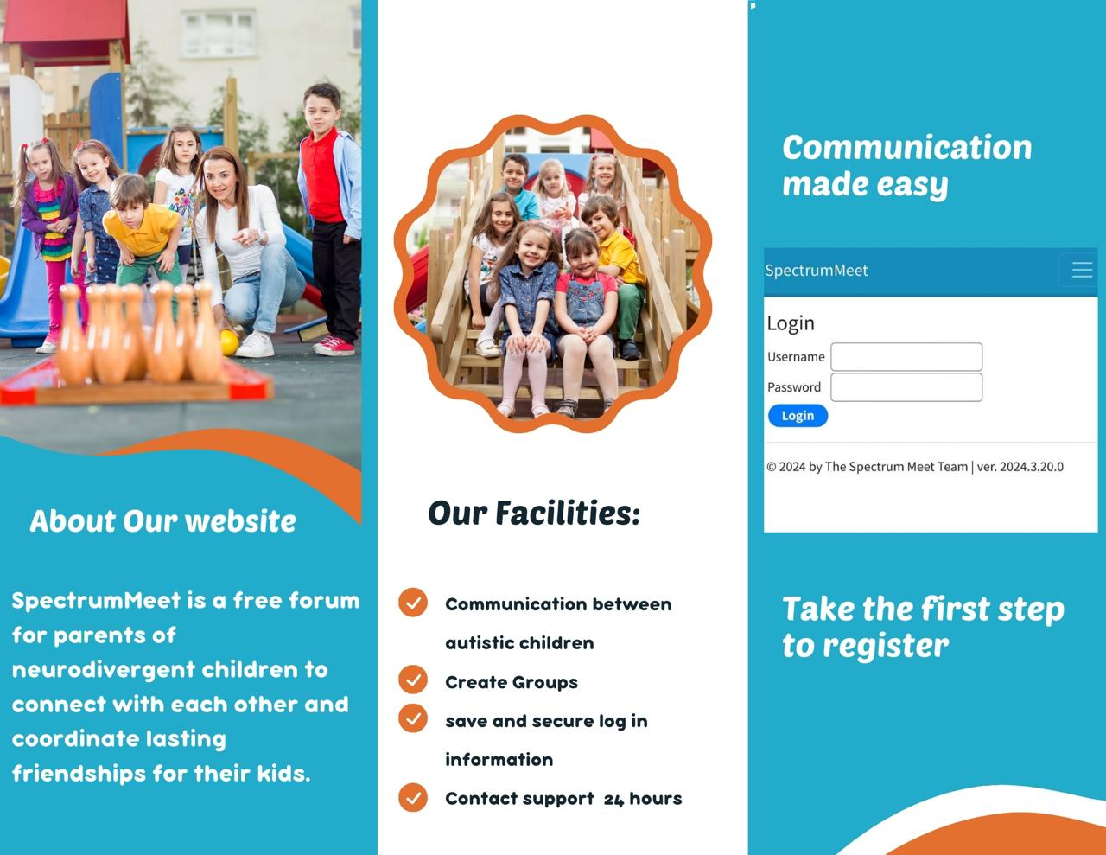

Slide 18
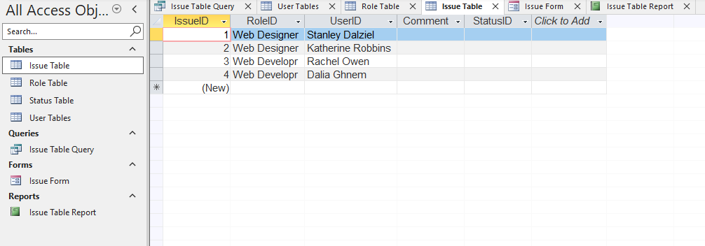
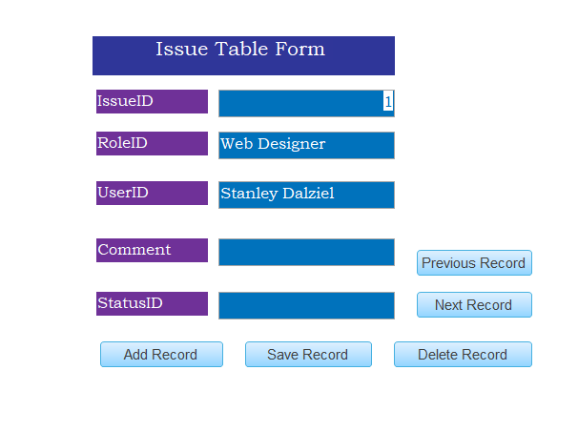

Slide 19
Thank You

